Slide 1
Text classification - IMDB
Prof. Yong Won SEO, Ph.D.
College of Business and Economics
Chung-Ang University

Slide 2
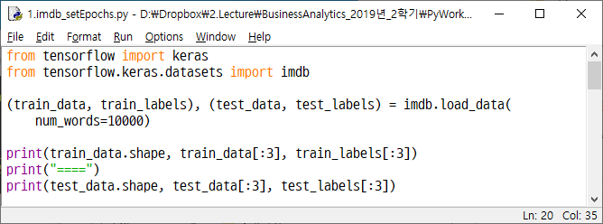

Slide 3
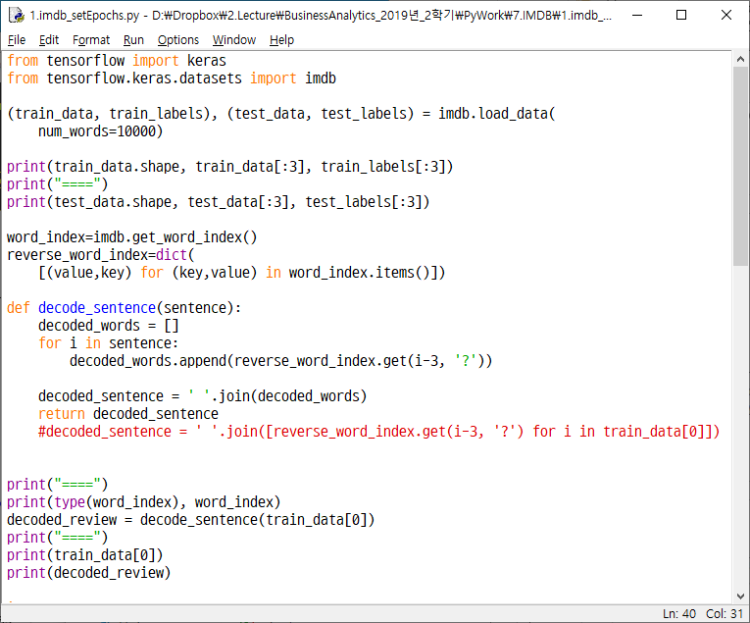

Slide 4
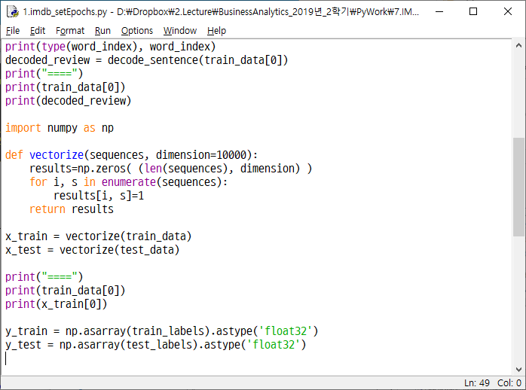

Slide 5
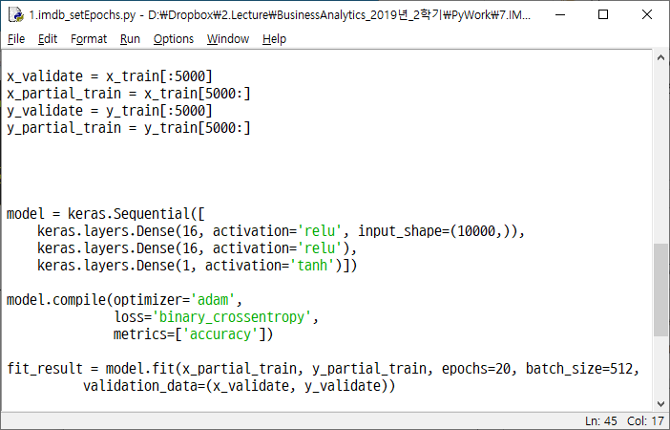

Slide 6
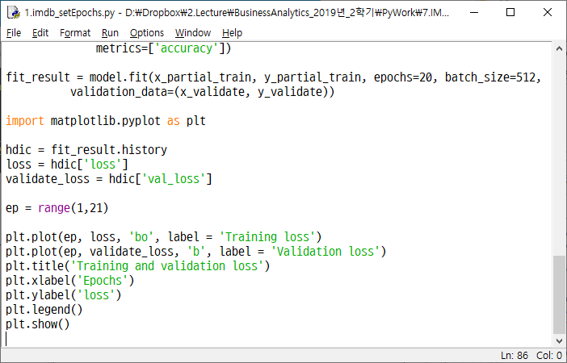

Slide 7
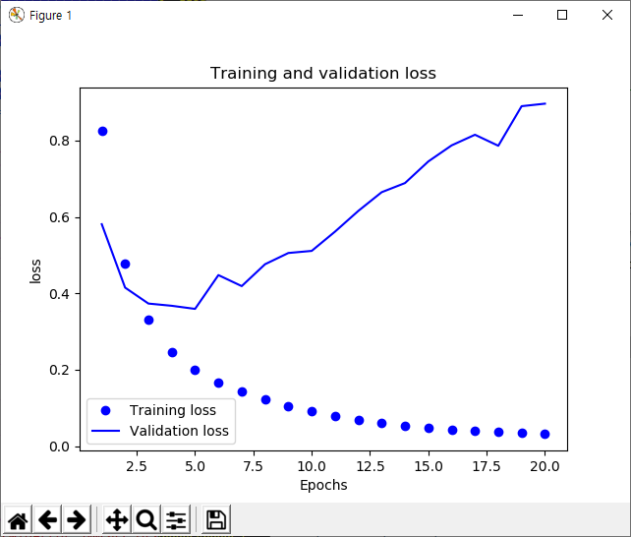

Slide 8
Overfitting

Slide 9
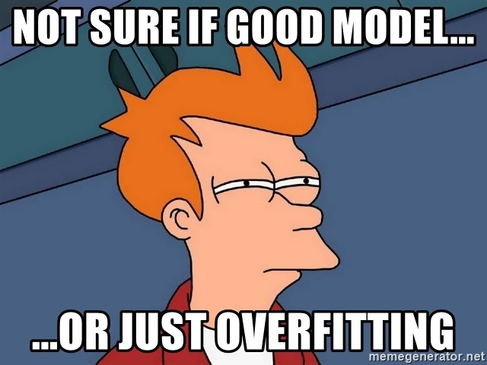

Slide 10
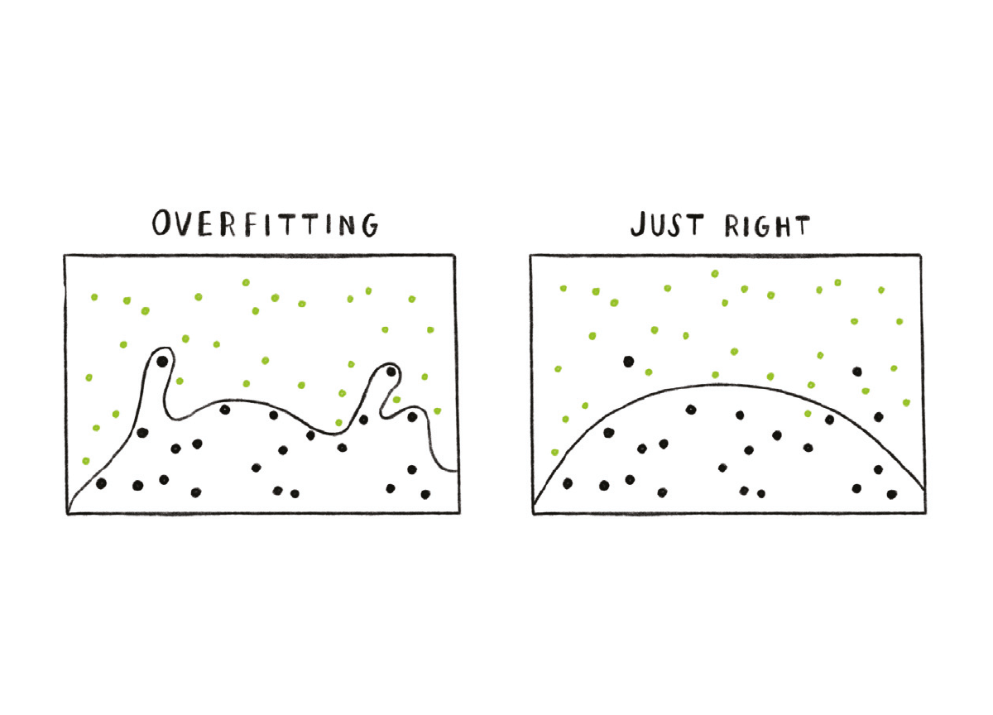

Slide 11
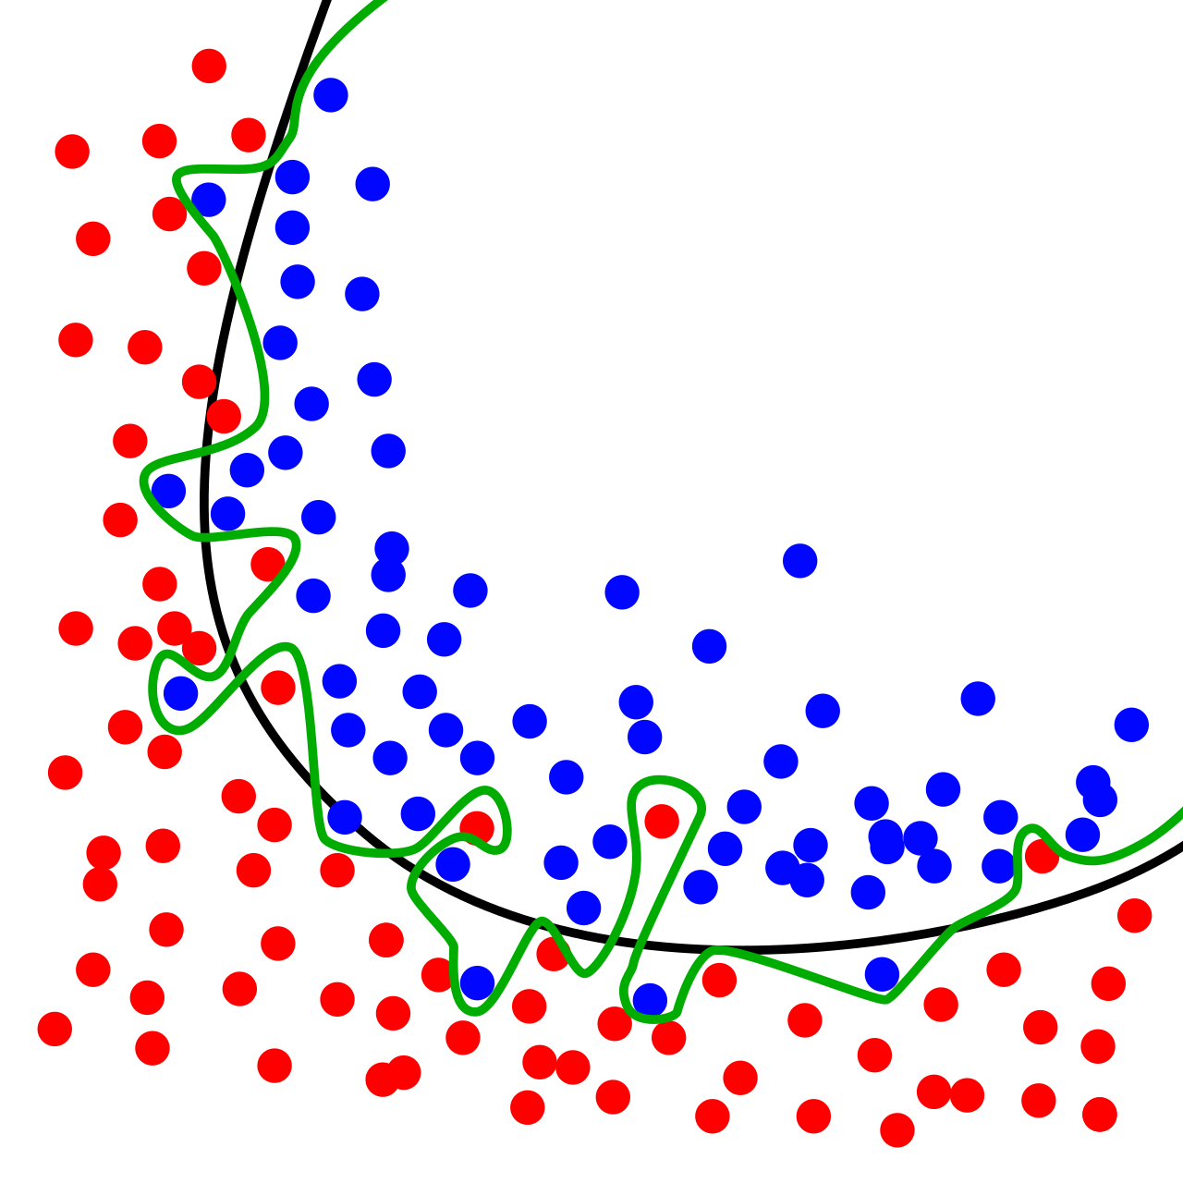

Slide 12
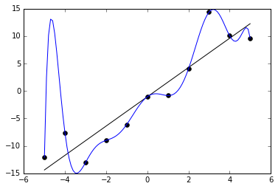

Slide 13
How to avoid overfitting?
Separate train set and test set
Divide train set into validate set and partial train set
Tune parameters (# of epochs etc.) for partial train set, testing for validate set
When parameter tuning completed, train for whole train set
Apply to test set
Various other ways to avoid overfitting is being used

Slide 14
